Slide 1




Transactions
Transaction Concept
Transaction State
Implementation of Atomicity and Durability
Concurrent Executions
Serializability
Recoverability
Implementation of Isolation
Transaction Definition in SQL
Testing for Serializability.

Slide 2
Basic concept of a Transaction, Transaction Management, Properties of Transactions, Concept of Schedule, Serial Schedule,
Serializability: Conflict and View, Testing conflict and view serializability, Recoverable and Non-recoverable Schedules, Concurrency Control: Need, Locking Methods, Deadlocks, Timestamping Methods, Different Crash Recovery methods such as Shadow-Paging and Log-Based Recovery: Deferred and Immediate, Checkpoints, Introduction to Query Processing and Query Optimization, Performance Tuning in SQL.

Slide 3
Transaction Concept
A transaction is a unit of program execution that accesses and possibly updates various data items.
A transaction must see a consistent database.
During transaction execution the database may be inconsistent.
When the transaction is committed, the database must be consistent.
Two main issues to deal with:
  Failures of various kinds, such as hardware failures and system crashes
  Concurrent execution of multiple transactions

Slide 4
ACID Properties
To preserve integrity of data, the database system must ensure:
Atomicity. Either all operations of the transaction are properly reflected in the database or none are.
Consistency: To preserve the consistency of database, the execution of transaction should take place in isolation (that means no other transaction should run concurrently when there is a transaction already running).
For example account A is having a balance of 400$ and it is transferring 100$ to account B & C both.
Isolation. Although multiple transactions may execute concurrently, each transaction must be unaware of other concurrently executing transactions. Intermediate transaction results must be hidden from other concurrently executed transactions.
 That is, for every pair of transactions T_{i} and T_{j}, it appears to T_{i} that either T_{j}, finished execution before T_{i} started, or T_{j} started execution after T_{i} finished.
Durability. After a transaction completes successfully, the changes it has made to the database persist, even if there are system failures.

Slide 5
Example of Fund Transfer
Transaction to transfer $50 from account A to account B:
  read(A)
2. A := A – 50
write(A)
read(B)
5. B := B + 50
6. write(B)
Atomicity requirement
If the transaction fails after step 3 and before step 6, money will be “lost” leading to an inconsistent database state
 Failure could be due to software or hardware
The system should ensure that updates of a partially executed transaction are not reflected in the database

Slide 6
Durability requirement — once the user has been notified that the transaction has completed (i.e., the transfer of the $50 has taken place), the updates to the database by the transaction must persist even if there are software or hardware failures.

Slide 7
Consistency requirement – the sum of A and B is unchanged by the execution of the transaction.(In general, consistency requirements include
 Explicitly specified integrity constraints such as primary keys and foreign keys
 Implicit integrity constraints
– e.g.,balances of accounts, minus withdraw amounts must equal value of cash-in-hand
A transaction, when starting to execute, must see a consistent database.
During transaction execution the database may be temporarily inconsistent.
When the transaction completes successfully the database must be consistent
Erroneous transaction logic can lead to inconsistency)

Slide 8
Isolation requirement — if between steps 3 and 6 (of the fund transfer transaction) , another transaction T2 is allowed to access the partially updated database, it will see an inconsistent database (the sum A + B will be less than it should be).
T1
1. read(A)
2. A := A – 50
3. write (A)
T2
read(A), read(B), print(A+B)
4. read(B)
5. B := B + 50
6. write (B
Isolation can be ensured trivially by running transactions serially
That is, one after the other.
However, executing multiple transactions concurrently has significant benefits, as we will see later.
14.8

Slide 9
Example of Fund Transfer (Cont.)
Durability requirement — once the user has been notified that the transaction has completed (i.e., the transfer of the
$50 has taken place), the updates to the database by the transaction must persist despite failures.
Isolation requirement — if between steps 3 and 6, another transaction is allowed to access the partially updated database, it will see an inconsistent database
(the sum A + B will be less than it should be).
Can be ensured trivially by running transactions serially, that is one after the other. However, executing multiple transactions concurrently has significant benefits, as we will see.

Slide 10
Transaction State
Active – the initial state; the transaction stays in this state while it is executing
Partially committed – after the final statement has been executed.
Failed -- after the discovery that normal execution can no longer proceed.
Aborted – after the transaction has been rolled back and the database restored to its state prior to the start of the transaction. Two options after it has been aborted:
Restart the transaction

can be done only if no internal logical error
Kill the transaction
Committed – after successful completion.
14.10

Slide 11
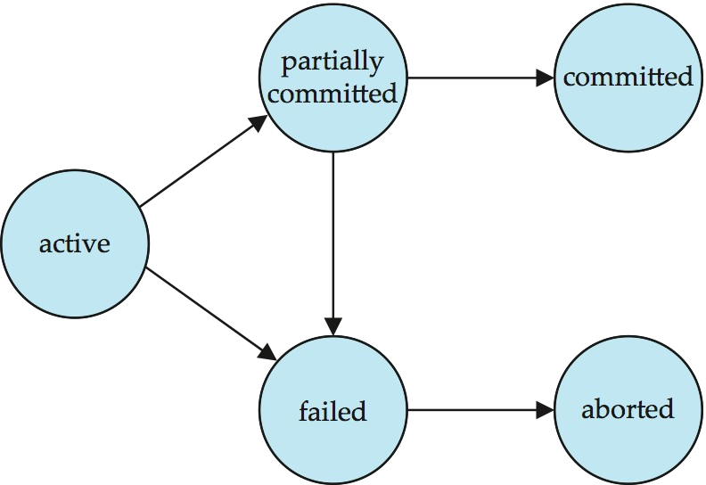
Transaction State ( Cont.)
14.11

Slide 12
Concurrent Executions
Multiple transactions are allowed to run concurrently in the system. Advantages are:
Increased processor and disk utilization, leading to better transaction throughput
 E.g. one transaction can be using the CPU while another is reading from or writing to the disk
Reduced average response time for transactions: short transactions need not wait behind long ones.
Concurrency control schemes – mechanisms to achieve isolation
That is, to control the interaction among the concurrent transactions in order to prevent them from destroying the consistency of the database
 Will study in Chapter 15, after studying notion of correctness of concurrent executions.

Slide 13
Schedules
Schedule – a sequences of instructions that specify the chronological order in which instructions of concurrent transactions are executed
A schedule for a set of transactions must consist of all instructions of those transactions
Must preserve the order in which the instructions appear in each individual transaction.
A transaction that successfully completes its execution will have a
commit instructions as the last statement
By default transaction assumed to execute commit instruction as its last step
A transaction that fails to successfully complete its execution will have an abort instruction as the last statement

Slide 14
Implementation of Atomicity and Durability
The recovery-management component of a database system implements the support for atomicity and durability.
The shadow-database scheme:
  assume that only one transaction is active at a time.
  a pointer called db_pointer always points to the current consistent copy of the database.
  all updates are made on a shadow copy of the database, and db_pointer is made to point to the updated shadow copy only after the transaction reaches partial commit and all updated pages have been flushed to disk.
  in case transaction fails, old consistent copy pointed to by db_pointer can be used, and the shadow copy can be deleted.

Slide 15
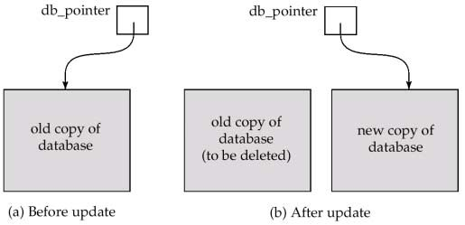
Implementation of Atomicity and Durability (Cont.)
The shadow-database scheme:
Assumes disks to not fail
Useful for text editors, but extremely inefficient for large
databases: executing a single transaction requires copying
the entire database. Will see better schemes in Chapter 17.

Slide 16
Concurrent Executions
Multiple transactions are allowed to run concurrently in the system. Advantages are:
  increased processor and disk utilization, leading to better transaction throughput: one transaction can be using the CPU while another is reading from or writing to the disk
  reduced average response time for transactions: short transactions need not wait behind long ones.
Concurrency control schemes – mechanisms to achieve isolation, i.e., to control the interaction among the concurrent transactions in order to prevent them from destroying the consistency of the database
  Will study in Chapter 14, after studying notion of correctness of concurrent executions.

Slide 17
Schedules
Schedules – sequences that indicate the chronological order in which instructions of concurrent transactions are executed
  a schedule for a set of transactions must consist of all instructions of those transactions
  must preserve the order in which the instructions appear in each individual transaction.

Slide 18
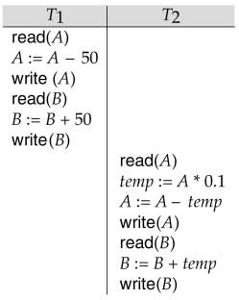
Example Schedules
Let T₁ transfer $50 from A to B, and T₂ transfer 10% of the balance from A to B. The following is a serial schedule (Schedule 1 in the text), in which T₁ is followed by T₂.

Slide 19
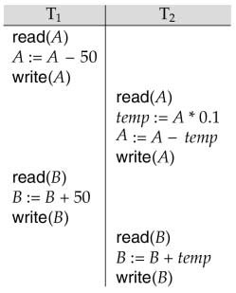
Example Schedule (Cont.)
Let T₁ and T₂ be the transactions defined previously. The following schedule (Schedule 3 in the text) is not a serial schedule, but it is equivalent to Schedule 1.
In both Schedule 1 and 3, the sum A + B is preserved.

Slide 20
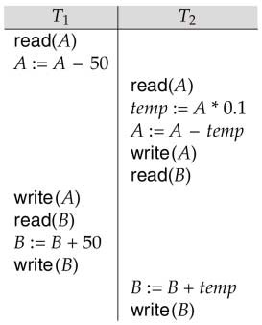
Example Schedules (Cont.)
The following concurrent schedule (Schedule 4 in the text) does not preserve the value of the the sum A + B.

Slide 21
Serializability
Basic Assumption – Each transaction preserves database consistency.
Thus serial execution of a set of transactions preserves database consistency.
A (possibly concurrent) schedule is serializable if it is equivalent to a serial schedule. Different forms of schedule equivalence give rise to the notions of:
  conflict serializability
  view serializability
We ignore operations other than read and write instructions, and we assume that transactions may perform arbitrary computations on data in local buffers in between reads and writes. Our simplified schedules consist of only read and
write instructions.

Slide 22
Conflict Serializability
Instructions l_{i} and l_{j} of transactions T_{i} and T_{j} respectively, conflict if and only if there exists some item Q accessed by both l_{i} and l_{j}, and at least one of these instructions wrote Q.
  l_{i} = read(Q), l_{j} = read(Q). l_{i} and l_{j} don’t conflict.
  l_{i} = read(Q), l_{j} = write(Q). They conflict.
  l_{i} = write(Q), l_{j} = read(Q). They conflict
  l_{i} = write(Q), l_{j} = write(Q). They conflict
Intuitively, a conflict between l_{i} and l_{j} forces a (logical) temporal order between them. If l_{i} and l_{j} are consecutive in a schedule and they do not conflict, their results would remain the same even if they had been interchanged in the schedule.

Slide 23
Conflict Serializability (Cont.)
If a schedule S can be transformed into a schedule S´ by a series of swaps of non-conflicting instructions, we say that S and S´ are conflict equivalent.
We say that a schedule S is conflict serializable if it is conflict equivalent to a serial schedule
Example of a schedule that is not conflict serializable:
^{T}3 ^{T}4
read(Q)
write(Q)
write(Q)
We are unable to swap instructions in the above schedule to obtain either the serial schedule < T₃, T₄ >, or the serial schedule < T₄, T₃ >.

Slide 24
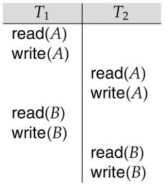
Conflict Serializability (Cont.)
Schedule 3 below can be transformed into Schedule 1, a serial schedule where T₂ follows T₁, by series of swaps of non-conflicting instructions. Therefore Schedule 3 is conflict serializable.

Slide 25
View Serializability
Let S and S´ be two schedules with the same set of transactions. S and S´ are view equivalent if the following three conditions are met:
  For each data item Q, if transaction T_{i} reads the initial value of Q in schedule S, then transaction T_{i} must, in schedule S´, also read the initial value of Q.
  For each data item Q if transaction T_{i} executes read(Q) in schedule S, and that value was produced by transaction T_{j} (if any), then transaction T_{i} must in schedule S´ also read the value of Q that was produced by transaction T_{j} .
  For each data item Q, the transaction (if any) that performs the final write(Q) operation in schedule S must perform the final write(Q) operation in schedule S´.
As can be seen, view equivalence is also based purely on reads
and writes alone.

Slide 26
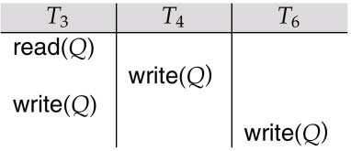
View Serializability (Cont.)
A schedule S is view serializable it is view equivalent to a serial schedule.
Every conflict serializable schedule is also view serializable.
Schedule 9 (from text) — a schedule which is view-serializable but not conflict serializable.
Every view serializable schedule that is not conflict serializable has blind writes.

Slide 27
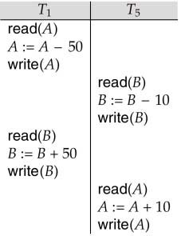
Other Notions of Serializability
Schedule 8 (from text) given below produces same outcome as the serial schedule < T₁, T₅ >, yet is not conflict equivalent or view equivalent to it.
Determining such equivalence requires analysis of operations other than read and write.

Slide 28
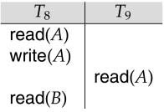
Recoverability
Need to address the effect of transaction failures on concurrently running transactions.
Recoverable schedule — if a transaction T_{j} reads a data items previously written by a transaction T_{i} , the commit operation of T_{i} appears before the commit operation of T_{j}.
The following schedule (Schedule 11) is not recoverable if T₉
commits immediately after the read
If T₈ should abort, T₉ would have read (and possibly shown to the user) an inconsistent database state. Hence database must ensure that schedules are recoverable.

Slide 29
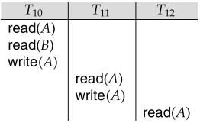
Recoverability (Cont.)
Cascading rollback – a single transaction failure leads to a series of transaction rollbacks. Consider the following schedule where none of the transactions has yet committed (so the schedule is recoverable)
If T₁₀ fails, T₁₁ and T₁₂ must also be rolled back.
Can lead to the undoing of a significant amount of work

Slide 30
Recoverability (Cont.)
Cascadeless schedules — cascading rollbacks cannot occur; for each pair of transactions T_{i} and T_{j} such that T_{j} reads a data item previously written by T_{i}, the commit operation of T_{i} appears before the read operation of T_{j}.
Every cascadeless schedule is also recoverable
It is desirable to restrict the schedules to those that are cascadeless

Slide 31
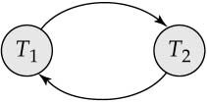
Testing for Serializability
Consider some schedule of a set of transactions T₁, T₂,
..., T_{n}
Precedence graph — a direct graph where the vertices are the transactions (names).
We draw an arc from T_{i} to T_{j} if the two transaction conflict, and T_{i} accessed the data item on which the conflict arose earlier.
We may label the arc by the item that was accessed.
Example 1
x
y

Slide 32
Example Schedule (Schedule A)
T₁ T₂ T₃ T₄ T₅
read(X)
read(Y) read(Z)
read(V) read(W) read(W)
read(Y) write(Y)
write(Z)
read(U)
read(Y) write(Y) read(Z) write(Z)
read(U) write(U)

Slide 33
Precedence Graph for Schedule A
T₁
T₂
T₄
T₃

Slide 34
Test for Conflict Serializability
A schedule is conflict serializable if and only if its precedence graph is acyclic.
Cycle-detection algorithms exist which take order n² time, where n is the number of vertices in the graph. (Better algorithms take order n + e where e is the number of edges.)
If precedence graph is acyclic, the serializability order can be obtained by a topological sorting of the graph. This is a linear order consistent with the partial order of the graph.
For example, a serializability order for Schedule A would be
T₅ → T₁ → T₃ → T₂ → T₄ .

Slide 35
Test for View Serializability
The precedence graph test for conflict serializability must be modified to apply to a test for view serializability.
The problem of checking if a schedule is view serializable falls in the class of NP-complete problems. Thus existence of an efficient algorithm is unlikely.
However practical algorithms that just check some sufficient conditions for view serializability can still be used.

Slide 36
Concurrency Control vs. Serializability Tests
Testing a schedule for serializability after it has executed is a little too late!
Goal – to develop concurrency control protocols that will assure serializability. They will generally not examine the precedence graph as it is being created; instead a protocol will impose a discipline that avoids nonseralizable schedules.
Will study such protocols in Chapter 16.
Tests for serializability help understand why a concurrency control protocol is correct.

Slide 37
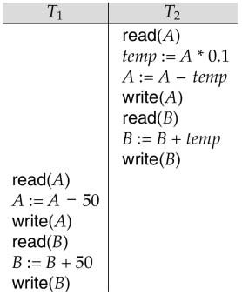
Schedule 2 -- A Serial Schedule in Which
T₂ is Followed by T₁

Slide 38
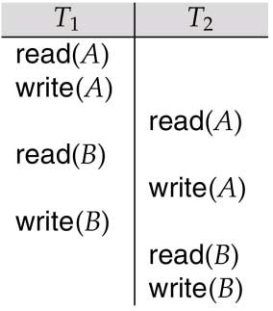
Schedule 5 -- Schedule 3 After Swapping A Pair of Instructions

Slide 39
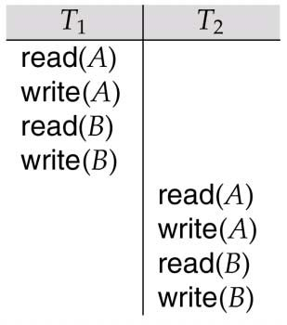
Schedule 6 -- A Serial Schedule That is Equivalent to Schedule 3

Slide 40
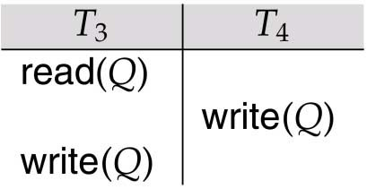
Schedule 7

Slide 41

Precedence Graph for
(a) Schedule 1 and (b) Schedule 2

Slide 42
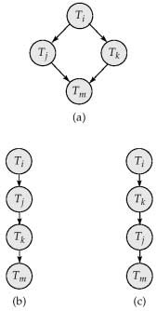
Illustration of Topological Sorting

Slide 43
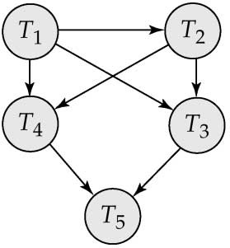
Precedence Graph

Slide 44
Concurrency Control: Need, Locking Methods, Deadlocks, Timestamping Methods, Different Crash Recovery methods such as Shadow-Paging and Log-Based Recovery: Deferred and Immediate, Checkpoints, Introduction to Query Processing and Query Optimization, Performance Tuning in SQL.

Slide 45
What is Concurrency Control?
Concurrency control is the procedure in DBMS for managing simultaneous operations without conflicting with each another.
Concurrent access is quite easy if all users are just reading data. There is no way they can interfere with one another.
Though for any practical database, would have a mix of reading and WRITE operations and hence the concurrency is a challenge.
Concurrency control is used to address such conflicts which mostly occur with a multi-user system.
It helps you to make sure that database transactions are performed concurrently without violating the data integrity of respective databases.
Therefore, concurrency control is a most important element for the proper functioning of a system where two or multiple database transactions that require access to the same data, are executed simultaneously.

Slide 46
Need of Concurrency method?
Why use Reasons for using Concurrency control method is DBMS:
To apply Isolation through mutual exclusion between conflicting transactions
To resolve read-write and write-write conflict issues
To preserve database consistency through constantly preserving execution obstructions
The system needs to control the interaction among the concurrent transactions. This control is achieved using concurrent-control schemes.
Concurrency control helps to ensure serializability

Slide 47
Example
Assume that two people who go to electronic kiosks at the same time to buy a movie ticket for the same movie and the same show time.
However, there is only one seat left in for the movie show in that particular theatre. Without concurrency control, it is possible that both moviegoers will end up purchasing a ticket.
However, concurrency control method does not allow this to happen. Both moviegoers can still access information written in the movie seating database. But concurrency control only provides a ticket to the buyer who has completed the transaction process first.

Slide 48
Concurrency Control Protocols
Different concurrency control protocols offer different benefits between the amount of concurrency they allow and the amount of overhead that they impose.
Lock-Based Protocols
Two Phase
Timestamp-Based Protocols
Validation-Based Protocols

Slide 49
Lock Based Protocols
A lock is a variable associated with a data item that describes a status of data item with respect to possible operation that can be applied to it. They synchronize the access by concurrent transactions to the database items. It is required in this protocol that all the data items must be accessed in a mutually exclusive manner. Let me introduce you to two common locks which are used and some terminology followed in this protocol.
Shared Lock (S): also known as Read-only lock. As the name suggests it can be shared between transactions because while holding this lock the transaction does not have the permission to update data on the data item. S-lock is requested using lock-S instruction.
Exclusive Lock (X): Data item can be both read as well as written. This is Exclusive and cannot be held simultaneously on the same data item. X-lock is requested using lock-X instruction.

Slide 50
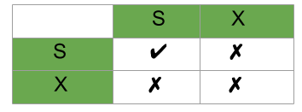
Lock Compatibility Matrix –
A transaction may be granted a lock on an item if the requested lock is compatible with locks already held on the item by other
transactions.
Any number of transactions can hold shared locks on an item, but if any transaction holds an exclusive(X) on the item no other transaction may hold any lock on the item.
If a lock cannot be granted, the requesting transaction is made to wait till all incompatible locks held by other transactions have been released. Then the lock is granted.

Slide 51
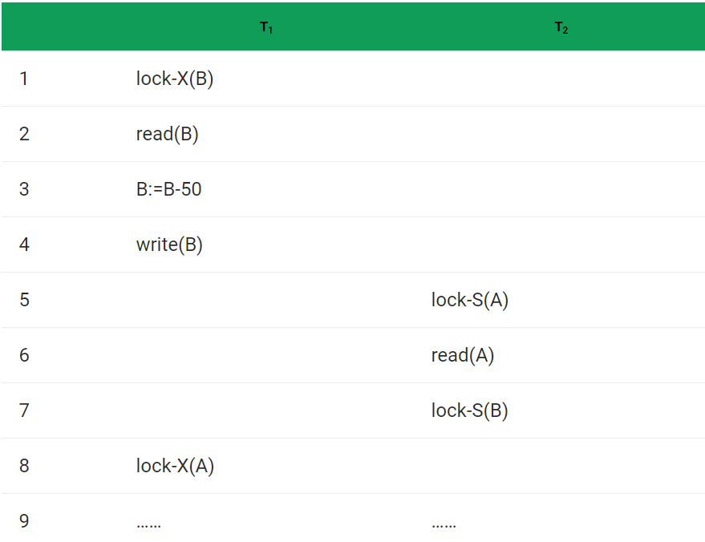
Consider the Partial Schedule:

Slide 52
Deadlock – consider the above execution phase. Now, T₁ holds an Exclusive lock over B, and T₂ holds a Shared lock over A. Consider Statement 7, T₂ requests for lock on B, while in Statement 8 T₁ requests lock on A. This as you may notice imposes a Deadlock as none can proceed with their execution.
Starvation – is also possible if concurrency control manager is badly designed. For example: A transaction may be waiting for an X-lock on an item, while a sequence of other transactions request and are granted an S-lock on the same item. This may be avoided if the concurrency control manager is properly designed.

Slide 53
Two Phase Locking Protocol
Previously two types of Locks available Shared S(a) and Exclusive X(a). Implementing this lock system without any restrictions gives us the Simple Lock based protocol (or Binary Locking), but it has its own disadvantages, they does not guarantee Serializability. Schedules may follow the preceding rules but a non-serializable schedule may result. To guarantee serializablity, we must follow some additional protocol concerning the positioning of locking and unlocking operations in every transaction. This is where the concept of Two Phase Locking(2-PL) comes
Two Phase Locking –
A transaction is said to follow Two Phase Locking protocol if Locking and Unlocking can be done in two phases.
Growing Phase: New locks on data items may be acquired but none can be released.
Shrinking Phase: Existing locks may be released but no new locks can be acquired.

Slide 54
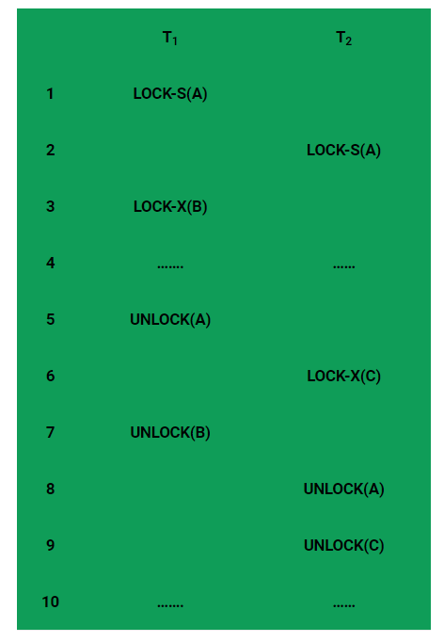

Slide 55
In above diagram this is just a skeleton transaction which shows how unlocking and locking works with 2-PL. Note for:
Transaction T₁:
Growing Phase is from steps 1-3.
Shrinking Phase is from steps 5-7.
Lock Point at 3
Transaction T₂:
Growing Phase is from steps 2-6.
Shrinking Phase is from steps 8-9.
Lock Point at 6

Slide 56
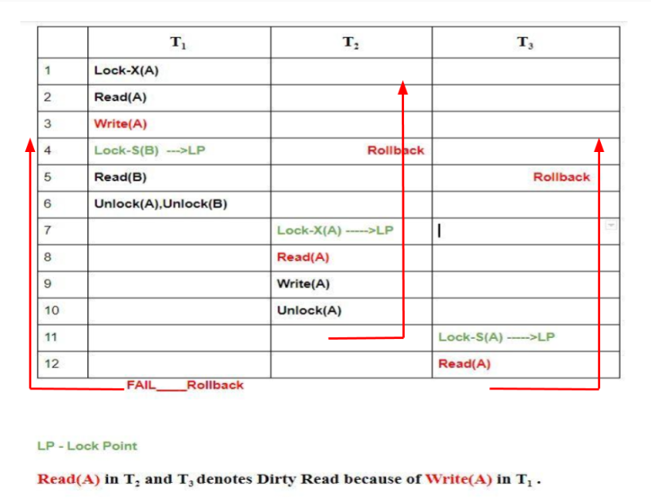
2-PL ensures serializablity, but there are still some drawbacks of 2-PL. Let’s glance at the drawbacks:
Cascading Rollback is possible under 2-PL.
Deadlocks and Starvation is possible.
Cascading Rollbacks in 2-PL –
Let’s see the following Schedule:

Slide 57
2 PL categories
Strict 2-PL
Rigorous 2-PL
Conservative 2-PL
Now recall the rules followed in Basic 2-PL, over that we make some extra modifications. Let’s now see what are the modifications and what drawbacks they solve.
Strict 2-PL –
This requires that in addition to the lock being 2-Phase all Exclusive(X) Locks held by the transaction be released until after the Transaction Commits.
Following Strict 2-PL ensures that our schedule is:
Recoverable
Cascadeless
Hence it gives us freedom from Cascading Abort which was still there in Basic 2-PL and moreover guarantee Strict Schedules but still Deadlocks are possible!
Rigorous 2-PL –
This requires that in addition to the lock being 2-Phase all Exclusive(X) and Shared(S) Locks held by the transaction be released until after the Transaction Commits.
Following Rigorous 2-PL ensures that our schedule is:
Recoverable
Cascadeless

Slide 58
Conservative 2-PL –
A.K.A Static 2-PL, this protocol requires the transaction to lock all the items it access before the Transaction begins execution by predeclaring its read-set and write-set. If any of the predeclared items needed cannot be locked, the transaction does not lock any of the items, instead it waits until all the items are available for locking.

Slide 59
Timestamp based Concurrency Control Protocol
The main idea for this protocol is to order the transactions based on their Timestamps. A schedule in which the transactions participate is then serializable and the only equivalent serial schedule permitted has the transactions in the order of their Timestamp Values. Stating simply, the schedule is equivalent to the particular Serial Order corresponding to the order of the Transaction timestamps. Algorithm must ensure that, for each items accessed by Conflicting Operations in the schedule, the order in which the item is accessed does not violate the ordering. To ensure this, use two Timestamp Values relating to each database item X.
W­_TS(X) is the largest timestamp of any transaction that executed write(X) successfully.
R_TS(X) is the largest timestamp of any transaction that executed read(X) successfully.

Slide 60
Basic Timestamp Ordering
Every transaction is issued a timestamp based on when it enters the system. Suppose, if an old transaction T_{i} has timestamp TS(T_{i}), a new transaction T_{j} is assigned timestamp TS(T_{j}) such that TS(T_{i}) < TS(T_{j}).The protocol manages concurrent execution such that the timestamps determine the serializability order. The timestamp ordering protocol ensures that any conflicting read and write operations are executed in timestamp order. Whenever some Transaction T tries to issue a R_item(X) or a W_item(X), the Basic TO algorithm compares the timestamp of T with R_TS(X) & W_TS(X) to ensure that the Timestamp order is not violated. This describe the Basic TO protocol in following two cases.
Whenever a Transaction T issues a W_item(X) operation, check the following conditions:
  If R_TS(X) > TS(T) or if W_TS(X) > TS(T), then abort and rollback T and reject the operation. else,
  Execute W_item(X) operation of T and set W_TS(X) to TS(T).
Whenever a Transaction T issues a R_item(X) operation, check the following conditions:
  If W_TS(X) > TS(T), then abort and reject T and reject the operation, else
  If W_TS(X) <= TS(T), then execute the R_item(X) operation of T and set R_TS(X) to the larger of TS(T) and current R_TS(X).

Slide 61
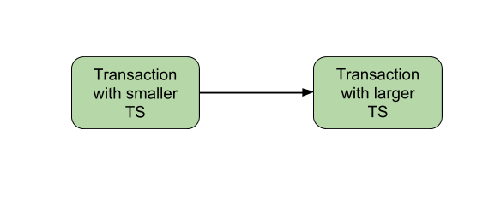
Whenever the Basic TO algorithm detects twp conflicting operation that occur in incorrect order, it rejects the later of the two operation by aborting the Transaction that issued it. Schedules produced by Basic TO are guaranteed to be conflict serializable. Already discussed that using Timestamp, can ensure that our schedule will be deadlock free.
One drawback of Basic TO protocol is that it Cascading Rollback is still possible. Suppose we have a Transaction T₁ and T₂ has used a value written by T₁. If T₁ is aborted and resubmitted to the system then, T must also be aborted and rolled back. So the problem of Cascading aborts still prevails.
Let’s gist the Advantages and Disadvantages of Basic TO protocol:
Timestamp Ordering protocol ensures serializablity since the precedence graph will be of the form:

Slide 62
Thomas Write Rule
Thomas Write Rule does not enforce Conflict Serializablity but rejects fewer Write Operations by modifying the check Operations for W_item(X)
If R_TS(X) > TS(T), then abort and rollback T and reject the operation.
If W_TS(X) > TS(T), then don’t execute the Write Operation and continue processing. This is a case of Outdated or Obsolete Writes. Remember, outdated writes are ignored in Thomas Write Rule but a Transaction following Basic TO protocol will abort such a Transaction.
If neither the condition in 1 or 2 occurs, then and only then execute the W_item(X) operation of T and set W_TS(X) to TS(T)

Slide 63
Basic TO Protocol v/s Thomas Write Rule –
Suppose user has a schedule in which two transactions T₁ and T₂. Now, TS(T₂) < TS(T₁). This implies that serializablity of schedule allowed is T₂ –> T₁ . Consider the two protocols, let us see what types of Operation will be allowed and not allowed under them. R_{i}(A) implies Read and W_{i}(A) implies Write operation. Now, let us look at the types of partial schedules allowed in both Basic TO and Thomas Write Rule, you’ll understand the difference in operations of both the protocol. User distinguish in operations Allowed and Not Allowed in both of the Protocols.
Basic TO ProtocolNot Allowed R₁(X) W₂(X) W₁(X) R₂(X) W₁(X) W₂(X) Allowed All operations where T₂ occurs before T₁. R₁(X) R₂(X) | Thomas Write RuleNot Allowed R₁(X) W₂(X) W₁(X) R₂(X) Allowed All operations where T₂ occurs before T₁. Outdated Writes: W₁(X) W₂(X) R₁(X) R₂(X)

Slide 64
References
Abraham Silberschatz ,HenryKorth , S.Sudarshan,"Database System concepts",5th Edition ,McGraw Hill International Edition
http://www.timeconsult.com/TemporalData/TemporalDB.html
http://punarvasi.com/different-types-of-database-users/
https://www.geeksforgeeks.org/
https://www.tutorialspoint.com/

Slide 65
END

